Slide 1
B V RAJU INSTITUTE OF TECHNOLOGY (UGC Autonomous) Vishnupur, Narsapur, Medak District
Department of CSE(Artificial Intelligence and Machine Learning)
Mini Project – Review
TruthMotion AI- A System for Identifying Deceptive Body Language
Guide :
Supervisor : Ms. B .Priyanka
Co-Supervisor : Ms. Srilakshmi V
Presented by :
Ch. Kavya Spoorthi 23211A6633

Slide 2
Outline
Abstract
Problem Statement
Literature Review
Research Gaps
Research Objectives
Methodology Adopted
Implementation

Slide 3
ABSTRACT
Deceptive behavior is often reflected through subtle nonverbal cues such as micro-expressions, gaze avoidance, and tense posture, which are difficult to detect in real time. This project proposes an AI system that analyzes short video clips to identify behavioral patterns commonly associated with deception. The system focuses on stress and discomfort indicators rather than verifying factual truth. Facial and body features are extracted using MediaPipe and analyzed using LSTM or Transformer-based models.The output provides stress and behavioral consistency scores to support ethical and non-intrusive behavior analysis.

Slide 4
PROBLEM STATEMENT
Identifying deceptive behavior through body language is challenging due to the subtle and involuntary nature of nonverbal cues such as micro-expressions, gaze shifts, and posture changes. Human observers often miss these signals, especially in high-pressure or real-time situations. Existing AI systems mainly focus on basic emotion detection and fail to analyze complex behavioral patterns over time. Therefore, there is a need for an intelligent, ethical, and non-intrusive AI system that can analyze nonverbal behavior from video data and identify patterns associated with deceptive body language.

Slide 5
LITERATURE REVIEW
S.no. | Year of publication | Title of paper with author name | Objectives | Methods /Approach | Inference
1 | 2025 | “Multimodal Machine Learning for Deception Detection” by G. Joshi et al. | To examine the impact of emotions on students’ motivation, self-regulation, and academic performance | Multimodal deception data were collected and fusion-based models were used to improve deception detection performance. | Multimodal fusion increases deception detection accuracy by around 15%, with behavioral cues contributing the most.
2 | 2025 | “Leveraging vision transformers and entropy-based modules for micro-expression recognition” by Zhang et al. & team focuses on ViT/HTNet developers | To improve micro-expression recognition by effectively capturing subtle and short-duration facial movements using advanced deep learning techniques. | Uses a Vision Transformer with entropy-based attention to focus on subtle facial movements for micro-expression recognition. | The proposed model achieves higher accuracy than existing CNN-based approaches in recognizing micro-expressions.

Slide 6
LITERATURE REVIEW
S.no. | Year of publication | Title of paper with author name | Objectives | Methods /Approach | Inference
3 | 2024 | " Micro-expression recognition based on a novel GCN and Transformer collaborative model” by Li et al. affiliated with GCN-Transformer research group | To improve micro-expression recognition by effectively modeling subtle facial muscle movements and their temporal dynamics. | A collaborative model that combines a Graph Convolutional Network to capture relationships among facial regions with a Transformer to model temporal expression changes. | The proposed GCN-Transformer model achieves higher accuracy than existing methods, demonstrating improved recognition of subtle micro-expressions.
4 | 2023 | “ Micro-expression Recognition Based on MobileVit-SE Block” by team from mobile vision experts | To develop an efficient and lightweight model for accurate micro-expression recognition suitable for real-time and resource-constrained applications. | Integrates MobileViT architecture with a Squeeze-and-Excitation (SE) block to capture both local facial details and global contextual features. | MobileViT-SE model achieves competitive accuracy with reduced computational complexity, making it effective for practical micro-expression recognition.

Slide 7
RESEARCH GAPS
Joshi et al. – Relies on physiological sensors, limiting scalability and real-world deployment without wearables.
Zhang et al. – Focuses on micro-expression recognition but does not apply it to deception or behavioral analysis.
Li et al. – Analyzes facial cues only, without combining posture, gaze, or full body language.
MobileViT-SE – Optimized for efficiency but not explored for deceptive or stress-related behavior detection.
Existing research lacks a unified, vision-based, and interpretable approach for detecting deceptive body language using combined facial and behavioral cues.

Slide 8
RESEARCH OBJECTIVES
To build an AI-based vision system that identifies deceptive body language by analyzing facial and behavioral cues over time.
That includes:
To analyze nonverbal cues such as facial micro-expressions, gaze behavior, posture, and body movements associated with deceptive behavior.
To develop a computer vision–based system that extracts facial and body language features from short video clips.
To apply deep learning models (LSTM/Transformer) to capture temporal behavior patterns related to deception.
To design a vision-based deception detection approach that does not rely on physiological sensors or wearables.
To evaluate the system’s effectiveness in identifying deceptive body language in an ethical and interpretable manner.

Slide 9
METHODOLOGY
Collect short video clips in controlled settings to capture natural nonverbal behavior.
Preprocess videos and extract frames for consistent analysis.
Use computer vision techniques to extract facial, gaze, posture, and motion features.
Organize extracted features as temporal sequences.
Apply LSTM or Transformer models to learn time-based behavioral patterns.
Analyze model outputs to estimate deception likelihood and stress indicators.

Slide 10
PROCESS FLOW CHART
Video Input
Frame Extraction & Preprocessing
Nonverbal Feature Extraction
Temporal Feature Sequencing
Deception Likelihood & Stress Scores
Deceptive Behavior Analysis
LSTM / Transformer Model
Fig. Process Flowchart

Slide 11
IMPLEMENTATION
Video input processing is done using OpenCV
Facial and body landmarks are extracted using MediaPipe Holistic
Frame to frame visualization of nonverbal behavioral cues as landmarks is extracted
Prototype classifies of truthful vs deceptive behavior using pre defined parameters
Execution is validated using publicly available video samples
The current status of the model is core pipeline being implemented and learnig based classification is planned

Slide 12
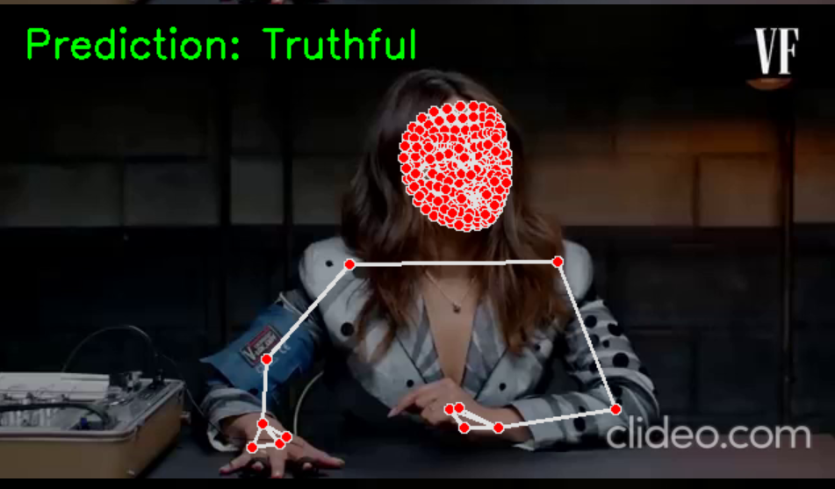
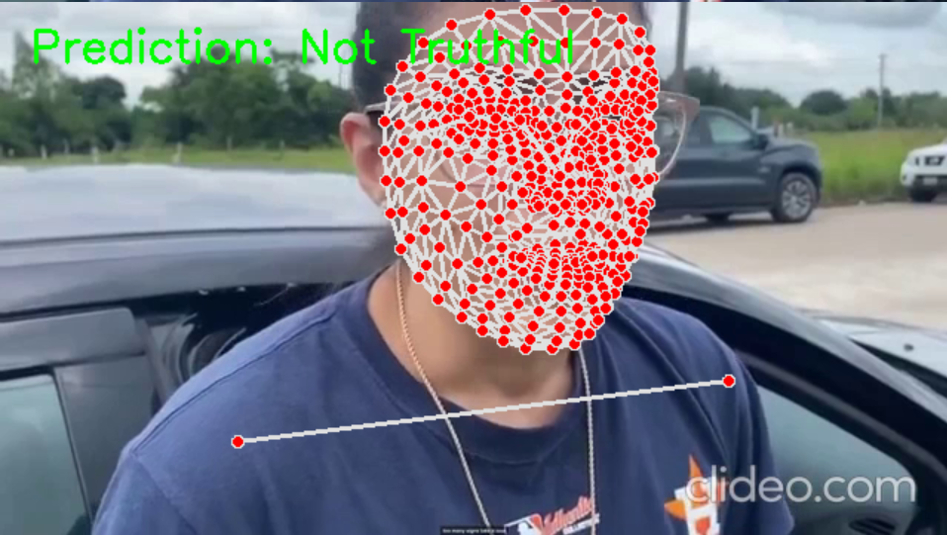

Slide 13
REFERENCES
Joshi, G., et al. (2025)
Multimodal Machine Learning for Deception Detection Using Behavioral and Neurophysiological Modalities.
🔗 Scientific Reports (Nature)
2. Zhang, X., et al. (2025)
Leveraging Vision Transformers and Entropy-Based Modules for Micro-Expression Recognition.
🔗 Scientific Reports (Nature)
https://www.nature.com/scientificreports
3. Li, Y., et al. (2024)
Micro-Expression Recognition Based on a Novel GCN and Transformer Collaborative Model.
🔗 IEEE Transactions on Affective Computing

Slide 14
Thank You

